Slide 1
German University in Cairo
Faculty of Engineering and Materials Science
Mechatronics Engineering Department
Pick and Place Robotic Arm
Presented by:
Team 07
Team Members:
Bassam Walid
Mostafa Shakweer
Somaya Magdy
Styven Hany
Yassin Hesham
Youssef Mohamed

Slide 2
Outline
System Overview
Kinematic Modeling
Pick-and-Place Trajectory Planning
Simulation & Hardware Results
Live Demonstration and Conclusion
Notes:
This presentation is organized as shown.

Slide 3
System Overview
4-DOF serial manipulator
Arduino-based control
Pick-and-place end effector
Simulated in Simscape & Gazebo

Slide 4
Kinematic Modeling
DH convention used for modeling
Forward & inverse kinematics obtained
Joint angles computed for pick/place points
Link (i) | θᵢ | dᵢ | aᵢ | αᵢ
1 (0→1) | q₁ | l₁ | 0 | π/2
2 (1→2) | q₂ + π/2 | 0 | l₂ | π
3 (2→3) | q₃ | 0 | l₃ | π
4 (3→4) | q₄ | 0 | l₄ | 0

Slide 5
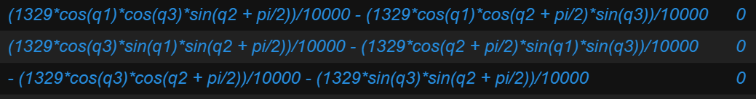
Kinematic Modeling
Jacobian of the system:

Slide 6
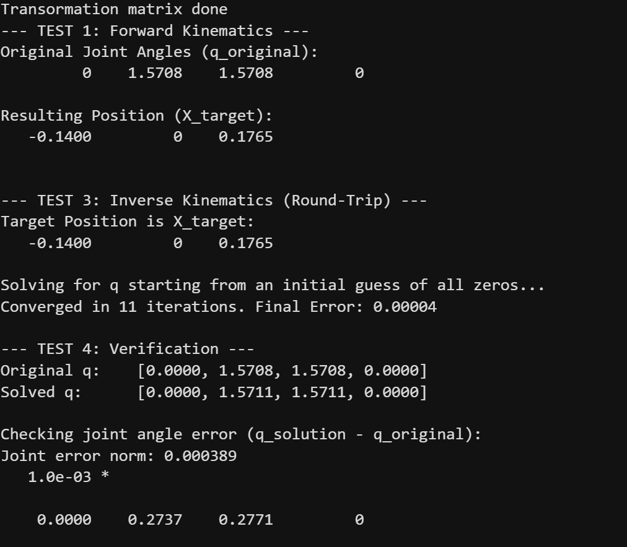
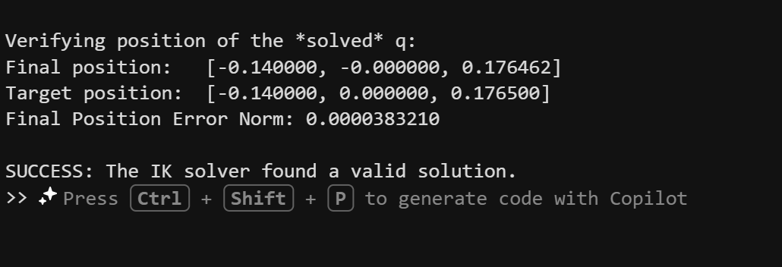
Kinematic Modeling
Position Kinematics forward and inverse tests:

Slide 7
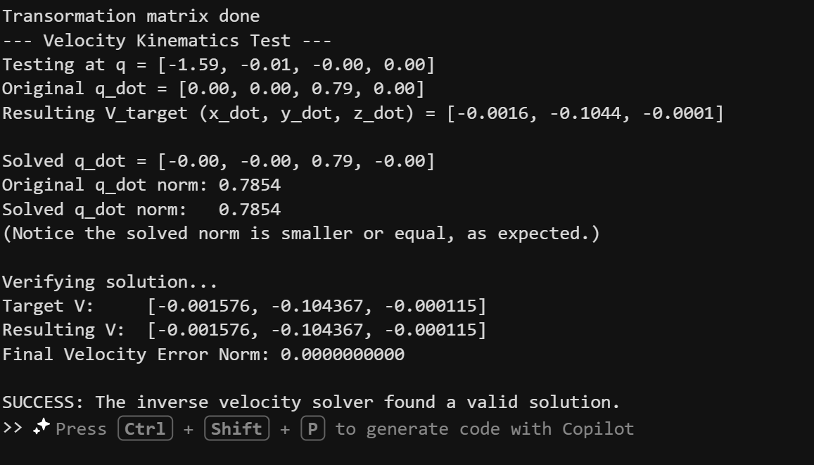
Kinematic Modeling
Velocity Kinematics forward and inverse:

Slide 8
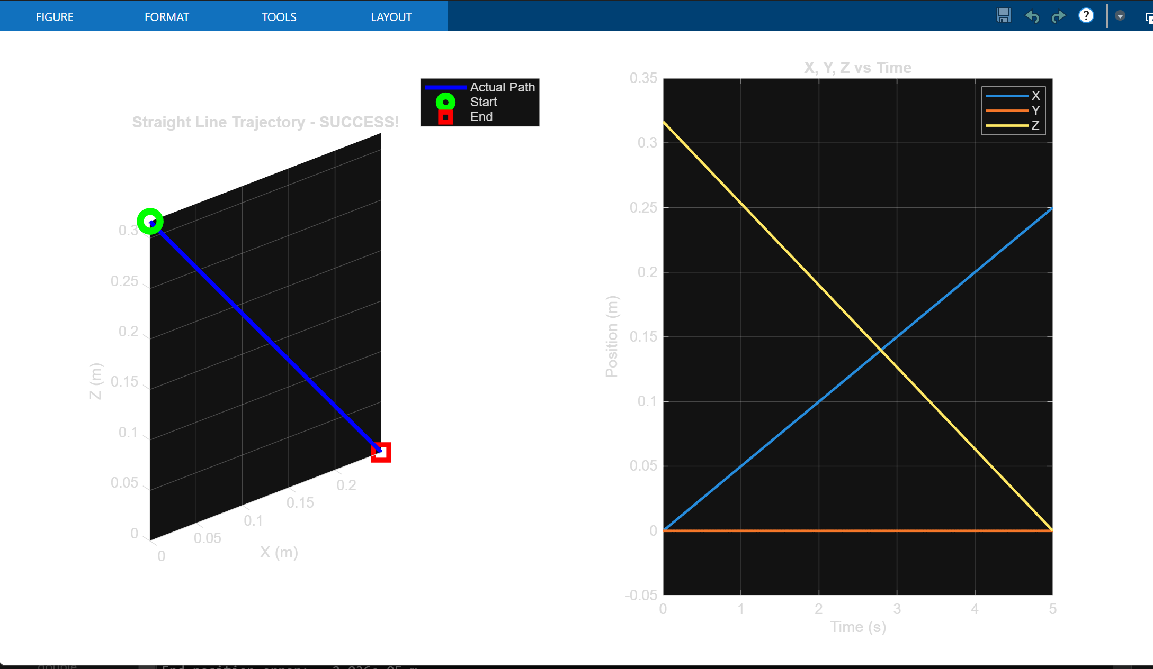
Pick-and-Place Trajectory Planning
Line Trajectory:

Slide 9
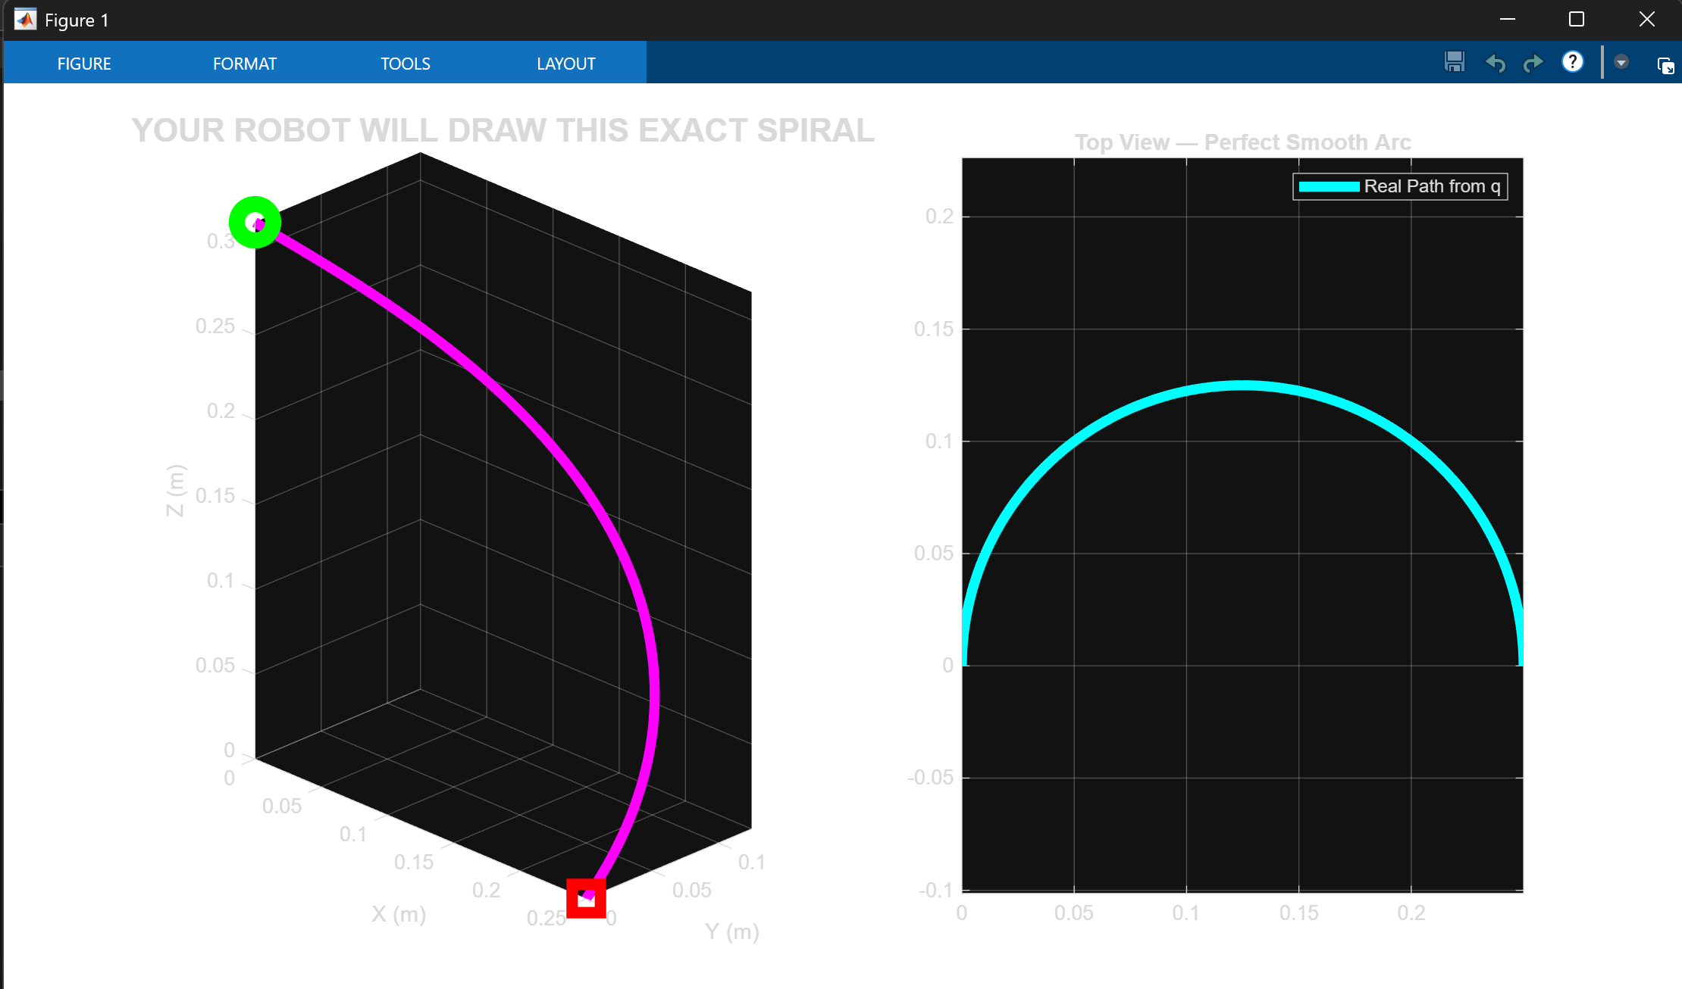
Pick-and-Place Trajectory Planning
Spiral Trajectory:

Slide 10
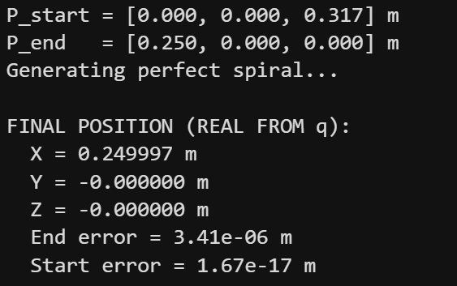
Pick-and-Place Trajectory Planning
Final Position Error:

Slide 11
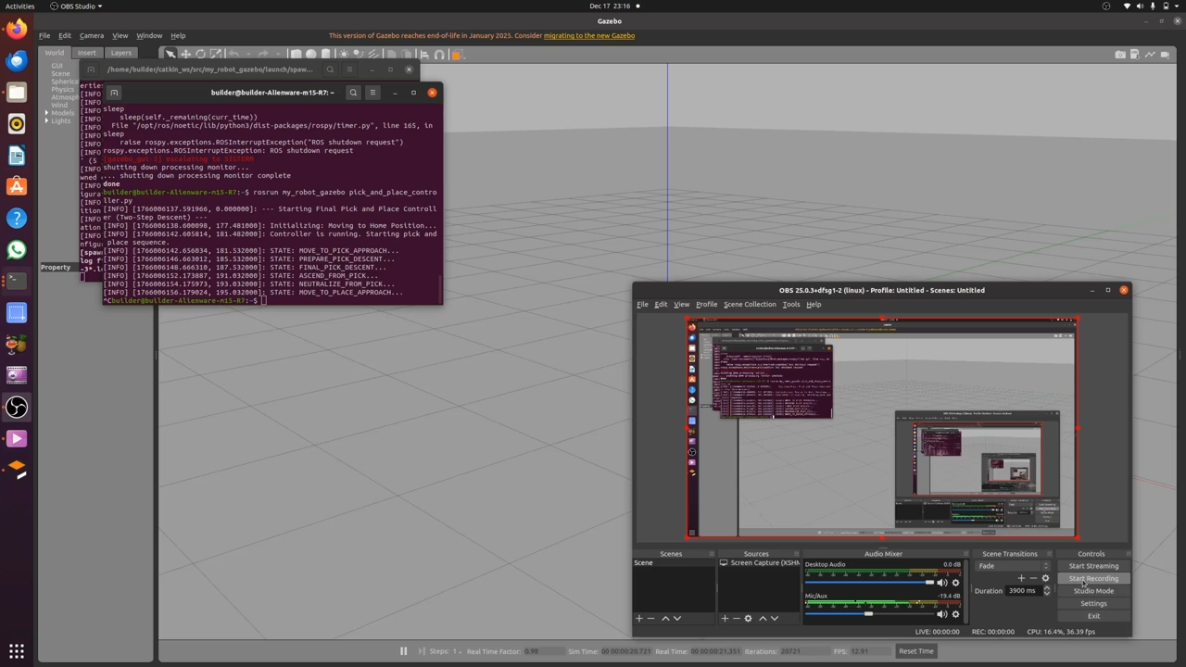
Pick-and-Place Trajectory Planning
Gazebo:

Slide 12
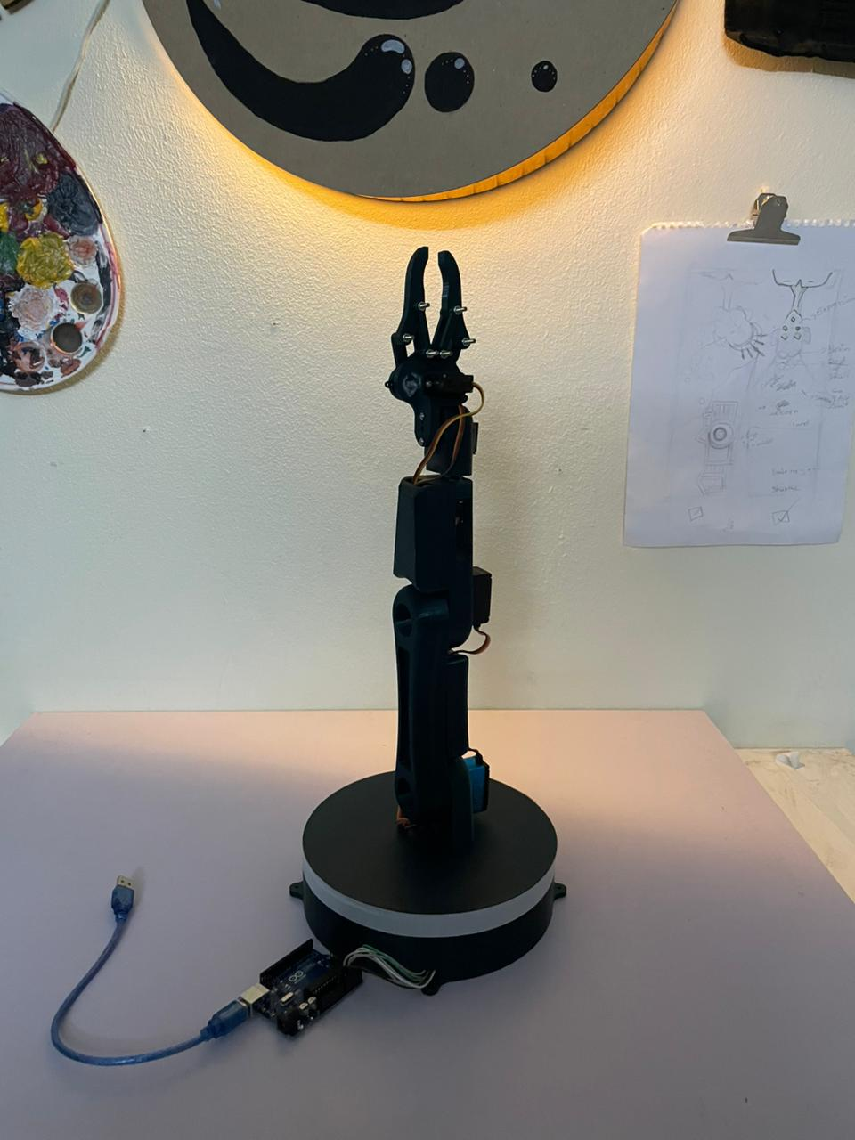
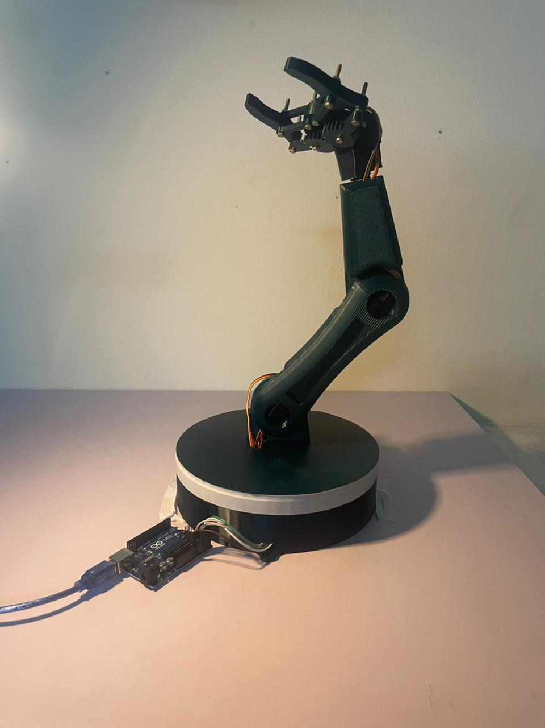
Simulation & Hardware Results
Our Hardware:

Slide 13
Live Demo
Live Demo

Slide 14

14
Notes:
This presentation is organized as shown. First, it is stated why robust control is required for quad-rotors, then a literature review of H-infinity based quad-rotor control is provided. Afterwards, the controller design is explained in detail. Then, simulation results are presented, and finally, the conclusion and future work are provided.

